Slide 1
Netball North West
2021/22
Annual General Meeting
26th September 2022

Slide 2
1. Apologies for Absence 2. Minutes of previous Annual General Meeting 3. Presentation of Board Reports & Accounts 4. Appointment of Auditors 5. Election of Regional Management Board Members 6. Ordinary Resolution
Agenda

Slide 3
1. Apologies for Absence
2. Minutes of previous AGM

Slide 4
3. Presentation of Board Reports & Accounts

Slide 5
Chair’s Report - Jenny Taylor
Successes
In the current year we have managed to retain and recruit within the RMB
Social media engagement has significantly increased, and we have created a fantastic community with North West members
The RMB have come together to successfully devise our Year 1 Plan for the new England netball Adventure Strategy
Evolving partnership with Thunder – shown in the joint One Awards & new locations for junior camps
Challenges
Ensuring consistency with umpiring standards and opportunities across the region (the Mentor Programme will aid this)
Developing the next 4 year section of the Adventure Strategy to make sure it is in line with what we need as a region (planning for this will commence approx. Jan/Feb 2023)
Recruiting volunteers and training them to support the region
Continuing to engage NW members on social media once VNSL starts and NWC 2023
Areas of focus moving forward
Strengthen our volunteer network to support those in leadership roles and help to fairly share the workload
Implement the Umpire Mentor Programme across the North West
Educating members on the Adventure Strategy to share and implement our vision across the region
Continue success of One Awards and aim to break this year’s record number of nominations

Slide 6
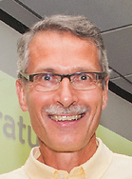
Vice chair Report - Phil Owen
Successes
12th June - Delivered Joint One Awards with Manchester Thunder. 80 separate nominations with over 230 attendees.
Recruitment to the RMB – Officiating - Comms and marketing – Volunteers
Several ‘Working As ONE’ meetings with RMB Volunteers and EN Staff
Initial draft of NW RMB Operational Plan completed and circulated
Challenges
Implementation and management of Operational Plan
Compliance with Tier 1
Raise the profile of RMB
Support Merseyside County Committee
Increase Volunteer capacity across RMB & County frameworks
Areas of focus moving forward
Ensure adherence to and completion of the Operational Plan
Tier 1 Compliance and completion of all Health Checks
Embrace EN ‘Working as one’

Slide 7
Communications & Marketing Report –
Richard Baxter
Successes
Significant growth in social media engagement during year (see appendix)
Stronger links in with Manchester Thunder & NW Counties and clubs
Launch of new NW Netball YouTube Channel
Better coverage of major EN competitions (eg. National Schools)
Challenges
Getting clubs to engage with NW Netball marketing initiatives
Maximising sign up for social channels – approx. 18% of target audience
Reaching all members through social media platforms
Limited engagement with NW Netball competitions
Areas of focus moving forward
Building NW specific content for SM platforms (e.g. Meet The Mentors / Umpires)
Driving engagement with junior members across marketing platforms – building bespoke content for their audience
Support Counties to improve SM and marketing presence
Drive and support better coverage of NW and National competitions that NW teams are part of
Broaden coverage to include Mixed netball and Men's netball to profile new growth areas of sport and diversity

Slide 8
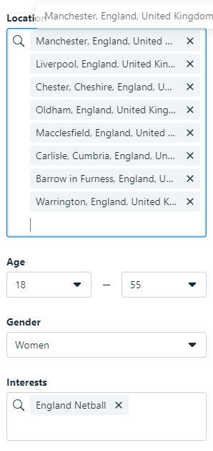
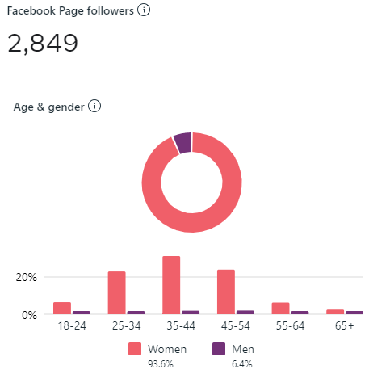
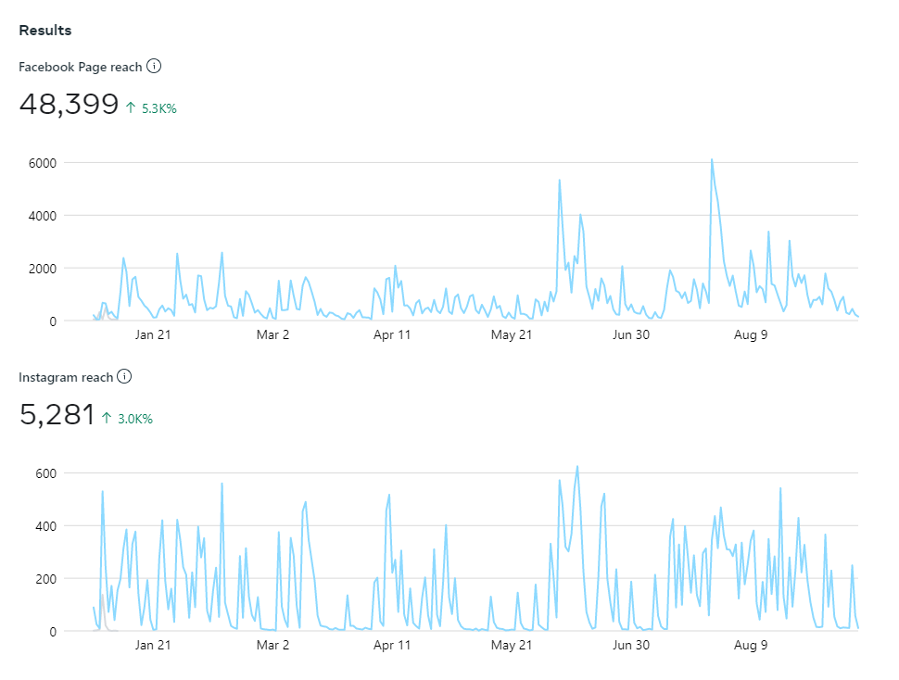
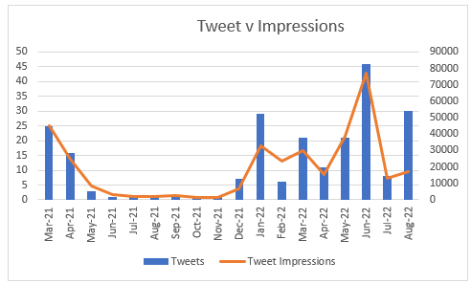
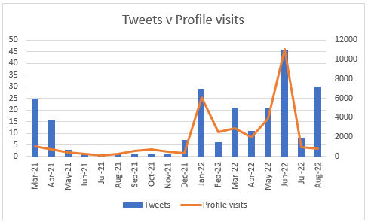
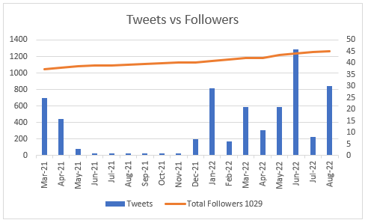
Communications & Marketing Report –
Richard Baxter

Slide 9
Competitions Report - Estelle Graham
Successes
8 x U16 & 9 x U14 junior clubs took part regional league
U16 National Champs – Bury (Oldham 5th) U14 National Champs – KWP (Oldham 3rd)
45 number of teams took part in regional senior league
Trafford promoted to EN Premier league 3
30 schools from 5 counties took part in regional schools
National Results
U19 Blue Coat 1st
U16 Cheadle 1st
U14 Withington 3rd
Team of 6 (EG, JC, JM, PT, RM, PE with support from Regional Chair) volunteers on TSG for competition
New format for 2022 for junior competition (details to follow) with enhancements for seniors

Slide 10
Competitions Report - Estelle Graham
Challenges
Revamp of regulations learning lessons from 2021-22 revamp including integration of officiating TSG recommendations
Availability of TSG volunteers leading to missed deadlines
Competing with non-EN recognised competitions
Overplaying of young athletes / calendar
Areas of focus moving forward / next steps
Revamp and planning of junior competition for 2022
Improve communication, results and general experience of taking part in the competition
Tightening up processes and procedure to manage the regional competitions
Creating events experience for central venue competition and play offs
Working with national group who are looking to standardise the regulations nationally as well as increase regional competitive options

Slide 11
Officiating Report – Chris McCall
Successes
Huge congratulations to all the following umpires on passing their officiating awards
2 umpires achieved the A Award qualification - Sophia Dahou and Nicola Cassidy
5 umpires passed their B Award Practical Assessment - Andrea Brockhurst, Netty Miles, Andrea Robinson, Sandra King, Karen McNicholl
6 umpires passed the A/B written assessment - Alex McIntyre, Madi Baxter, Louise Stapleton, Heather Stocker, Georgina Evans, Sarah Dodd
21 umpires attended a B Award Course, with another 18 attending a course in November
Revamped the Mentoring Programme - The programme has been developed to ensure a consistent approach across the North West. It is aimed at providing ongoing development opportunities for our umpires progressing to the B Award qualification, to support B Award Talent Identified umpires and those qualified umpires wanting to refresh their umpiring skills. If anyone would like to get involved in mentoring, contact jackie.cash@btconnect.com
Many thanks to Jackie for her commitment to this initiative and the mentors for their continued support.
Developed presentation for tutoring A/B written assessment
To complement the mentoring programme, a presentation has been developed for tutoring umpires doing the A/B written assessment. Tutoring sessions can be delivered via zoom, face-to-face or one-to-one. For further information on accessing a tutoring session please email nwofficiating@gmail.com.
Many thanks to Paula Burke and Netty Miles who have produced the presentation.

Slide 12
Officiating Report – Chris McCall
Challenges
Increasing conversion rates for umpires
Capacity to cope with the high volume of learners attending courses and applying for practical assessments, the pressure on our County Officiating Leads and assessors has been enormous. They have done a sterling job this past year organising and getting through a vast number of assessments.
Buy in and implementation of standardised fee structure
Coping with the negativity and resistance from various parties
Training new assessors & converting C Assessors to B
With a potential 17 trainee assessors and 7 C assessors wanting to convert to B assessors, the additional workload on the 4 Supervisory Assessors, completing paperwork, will be immense. I am exploring with EN the possibility of increasing the number of Supervisory Assessors to cope with the demand.

Slide 13
Officiating Report – Chris McCall
Areas of focus moving forward / next steps
Launching of the NW mentoring programme
We will be launching the new look programme in the next couple of weeks.
Next step is to adapt the programme for Counties to use for developing Into and C Award leaners.
Increasing the Assessor Workforce
The current list of NW Assessors has recently been reviewed and updated, as requested by EN. We have included our additional requirements, listing them in order of priority based on County’s with the greatest “need”, we identified an additional requirement of 17 assessors for the NW.
Standardising umpire expenses across the North West
Over recent years the NW has been experiencing an umpire ‘fee war’, with umpires requesting more than the recommended expenses. To address this the Officiating TSG has been tasked with developing a fee structure for the whole of the North West, with a view to ensuring a consistent and fair approach for umpires, clubs, players and their families.
Finally, a massive thank you to the County Officiating Leads for the work they have done this year within their counties and contribution to the region as members of the Officiating TSG.
The support they give to me is tremendous – working together as a great team.

Slide 14
Performance Report - Sam Longley
Successes
Quantity of successful athletes progressing through different stages
Links with Manchester Thunder
Programme run across 5 counties
Successful play days
Challenges
Congested calendar
Commitments/Focus/Priorities
England Netball Changes
Time, money, courts, staff
Areas of focus moving forward / next steps
Partnership with Manchester Thunder
Amended programme at Under 15’s – all counties working to same goals
Looking at trials across NW at 15’s age group
Finalise NW Performance Strategy - to include giving more guidelines of what we are looking for to aid clubs and schools.

Slide 15
Treasurers report - Sarah Sutton
Successes
Ellis & Co have prepared the accounts for the fifth year and a draft copy will be put
onto the website once signed off by the Board.
We are showing a small surplus this year of £1683.00 which was expected due to the fees being re-introduced on the return of Netball after Covid. We supported England Netball by removing our affiliation Fees for the 20/21 season which have now been re-introduced 21/22 Season*.
**Forthcoming Fees for Next Season - Remaining the same for 2022/23 season & 2023/24 season (1 Sept 23 – 31 Aug 24) *Over 18 =£1. Under 18 =£0.50
We also continue to offer support to athletes via our Bursary and Hardship Fund to help those who meet the criteria. https://www.netballnorthwest.org.uk/funding.html
We have had a small number of requests this year so will continue to provide this support using the allocated funds.
We have also supported Manchester Thunder by funding the umpire fees for their trials.
Supported the One Awards for the Volunteers which was a great success along with Thunders presence.
Challenges
None to report
**Added into slides after the AGM

Slide 16
Accounts Summary
Treasurers report - Sarah Sutton
1st September 2021
to 31st August 2022

Slide 17
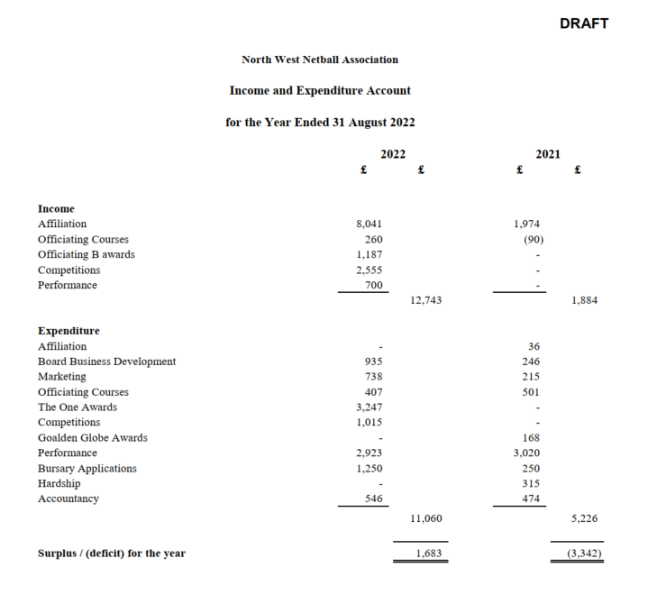
Treasurers report - Sarah Sutton

Slide 18
Ellis & Co Chartered Accountants & Business Advisors
4. Appointment of Auditors

Slide 19
Regional report By Caer Harrison - North West Partnership & Delivery Manager

Slide 20
AGM Report
England Netball update
September 2022
A year of recovery across the Region
Netball was able to restart in March 2021 with some mitigations and modified rules as we were still dealing with Covid 19.
Covid has still had a huge impact on our sport but with the support of all our dedicated members, clubs, leagues, region and counties we have managed to get so many women and girls back onto netball courts.
So, firstly a huge Thank You to each and everyone of you for supporting the Rise Again Campaign and for your continued passion for our wonderful sport.

Slide 21
England Netball Priorities for 21-22
Rebuild activity levels in England by reactivating national opportunities for every community with a focus on those most impacted by the pandemic
Reactivate clubs, leagues and competitions
Reactivate a nationwide programme offer
Re-energising a focus on equality, diversity and inclusion – those most impacted by the pandemic
Modernise our approach to Learning and Development to support the people in our game

Slide 22
National achievements from the year
We have now reached a new record number for members with over 108,250 people returning to a netball court. This exceeds the previous record set during the 2018/19 year, in between the Commonwealth Games and the Netball World Cup in Liverpool, where we had 107,500 members.
From 30th May EN will be pitching Bee Netball to clubs to excite, inspire and to motivate them about the evolution of the programme, any club wishing to deliver Bee Netball can join one of the welcome virtual sessions. We now have over 100 clubs who have shown an interest, and many are getting ready to offer this exciting programme to youngsters in September
Relaunch of the One Awards (formally Goalden Globes) with an online application process and new branding.
EN have been benchmarked as a C grading in the recent Race Representation Index (carried out by sporting equals) ended 6/26 form the organization that took part.
EN have supported a number of campaigns as part of Race Equality Week – staff used social media channels to support #ActionNotJustWords and #MyNameIs.
Extension of partnerships with Nike and Vitality.
EN published Diversity and Belonging report.
New EN 10-year adventure strategy officially launched on 25th November 2021.
New NW branding officially launched on 25th November 2021.
VNC and national forums have continued to be offered to members, to support them with their return to court. These include league, clubs, coaches, officials, and facilities.

Slide 23
North West Leagues and Clubs returned – 2021/22
Our aim was to return 100% of registered leagues and support 90% of our clubs to return to competition and/or training.
95 % registered leagues have returned (19/20)
95 % of clubs have returned (289/303) – with a mix of new clubs, merges and some clubs folding with any players still wanting to play joining new clubs
Figure 1: Table/ Graph showing breakdown of member League and Club return breakdown by county
 | TOTAL NUMBER | TOTAL ACTIVE NUMBER | Rate %
NUMBER OF CLUBS IN REGION | 303 | 289 | 95%
Small Club - Less than 20 People | 86 | 80 | 93%
Medium Club -21-50 People | 80 | 74 | 93%
Large Club - 51-100 People | 43 | 41 | 95%
Extra Large Club - 100+ People | 83 | 83 | 100%
Figure 2: Table/ graph showing breakdown of club size return by county
The North West team have continued to support their Counties with funding bids, facility issues, volunteer recruitment, care package information sharing
and training to support league return.

Slide 24
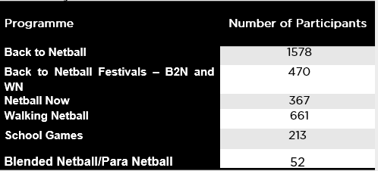
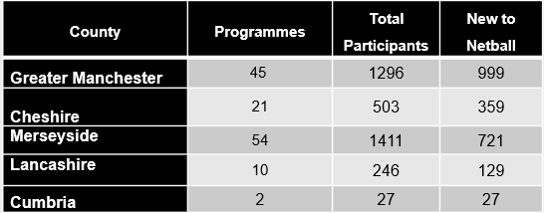
The team of NDOs and NDCCs have had a great year re-establishing many of the programmes that were offered pre pandemic, as well as setting up new programmes across the region.
There was a total of 143 programmes offered with 3483 participants taking to the court to play netball. The table below shows the total number of programmes and number of participants engaged for the April 21/ March 22 financial year.
Figure 3: Number of Programmes & number of participants by Region
Figure 4: Number of Programmes & number of participants by County

Slide 25
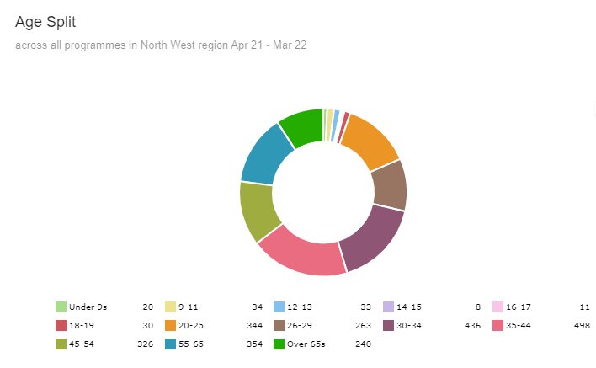
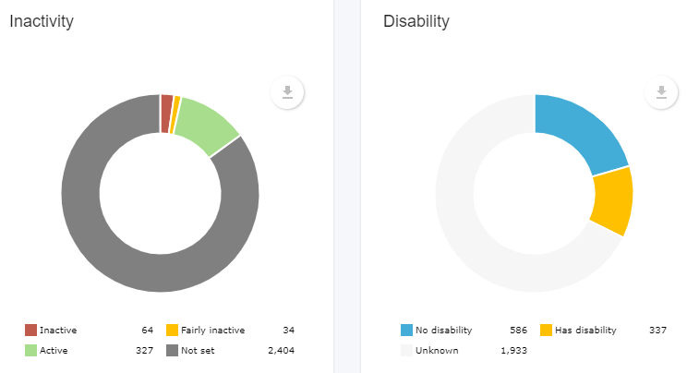
North West Regional Participation – 2021/22
The team of NDOs and NDCCs have had a great year re-establishing many of the programmes that were offered pre pandemic, as well as setting up new programmes across the region.
Of the 3483 total participants, 227 had logged a disability and 98 were either inactive or fairly inactive.
The largest proportion of our participants (almost half) coming from age groups 26-44
Figure 5: Regional participation by Age group
Figure 6; Proportion of participants by Inactivity and Disability

Slide 26
We have been consulting with the team, wider organisation, and partners to refresh our Partnership Network Team (PNT) structures and roles to align to the new Adventure Strategy. Following this consultation, we are excited to share some changes that have been implemented
Team and Job Titles –
Our new team name is: Partnerships & Delivery Team
The Head new job title is: Head of Partnerships & Delivery
The PM new title is: Partnerships & Delivery Manager
Regional Coordinators new title: Regional Officer
Regional Officers will report into the Partnership and Delivery Manager
In addition to the above we also introduced a 5th Partnership and Delivery Manager and have updated the geographical territories.
The new structure sees the North West region paired with North East and Caer Harrison continuing to lead in terms of Partnership & Delivery Manager
There has been no change to the NDO/NDCC structure and each County still has a England Netball member of staff to support the County, Leagues and Members. There has however been an update to the NDO and NDCC job description to reflect the adventure strategy over the next 10 years.
Partnerships Update & Other News

Slide 27
2022 Staffing structure
North West and North East Partnership | Post-COVID-19
Caer Harrison – Partnership and Delivery Manager
North West | North East
Team Leader – Eliza Morgan | Team Leader – Gemma White
Regional Officer– Helen Dulson | Regional Officer– – Jade Featherstone
Netball Development Officers Cumbria – Ashley Taylor Lancashire – Eliza Morgan Gtr Manchester – Abbey Barry Merseyside – Louise Moss Cheshire– Nichola Foulkes | Netball Development Officers Northumberland – Vacant North Durham and Tyne & Wear – Jessica Laidler South Durham and Cleveland – Tracy Reid
Netball Development Community Coaches Gtr Manchester – New person in role in October Merseyside – Katie Lambeth * maternity cover | Netball Development Community Coaches Newcastle & Gateshead – Gemma White
The region and counties saw some staffing changes during 21/22
- Lancashire NDO - Rachel Towell left the organisation in March. Eliza Morgan moved into the NDO position & transitioned from Gtr. Manchester NDCC.
- Cumbria NDO - Janine Walsham left the organisation in February and Ashley Taylor started with us in June 2022, working part time.
- Merseyside NDCC - Jewel Uchegbu left the organisation in May for maternity leave &Katie Lambeth joined us on a maternity cover from August 2022.
- Greater Manchester NDCC - We have successfully recruited into this position in October 2022.

Slide 28
Coaching, Officiating Courses
Courses are now being ran centrally by Learning & Development (L&D) rather than by the region.
EN Coaching courses
Level 1’s are now virtual.
Level 2’s blended*
*Virtual session(s) and practical session Face to Face.
Expression of interest form for courses.
Courses
Into officiating & C award are now being
held virtually and being ran centrally (L&D) rather
than by the region.
B award umpire courses are blended*
Walking Netball host training courses are still
Face to Face.
Bee course for Trailblazer clubs only.

Slide 29
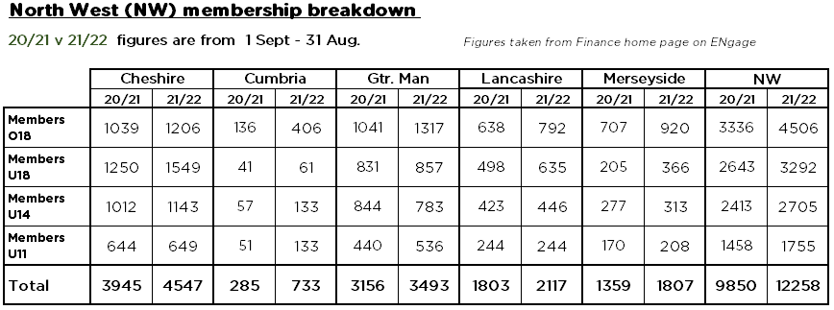
North West Region/County Membership Data
Number of 22/23 members on ENgage = 9873**
**as of 26/9/22

Slide 30
5. Election of Regional Board Members
Re-election
Vice Chair: Phil Owen
Competition: Estelle Graham
Finance: Sarah Sutton
Performance: Sam Longley
Officiating: Chris McCall
Volunteer: Uma Ramanathan
Interim - Election
Election

Slide 31
6. Ordinary Resolution
To align with the new Adventure strategy, under which point we are refreshing the terms of role appointments to run from 2022.

Slide 32
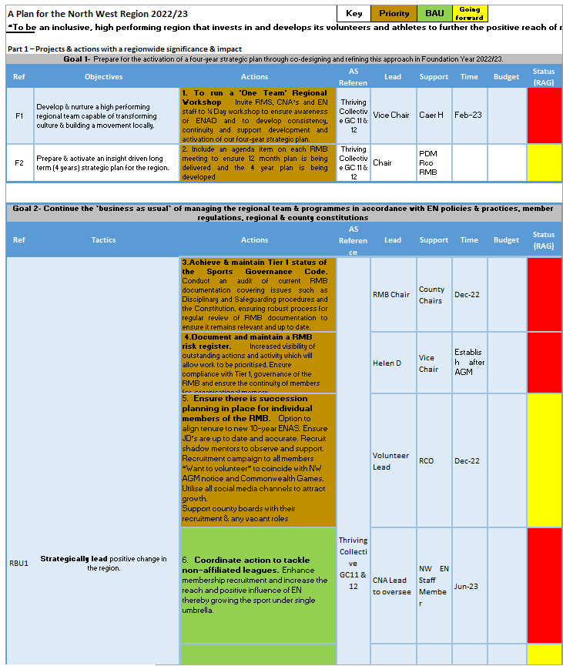
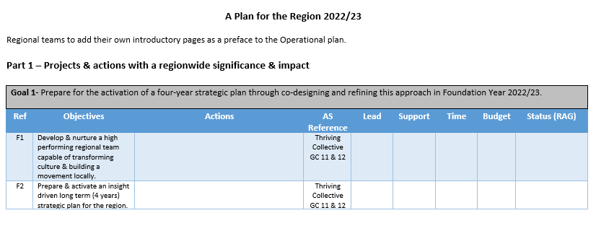
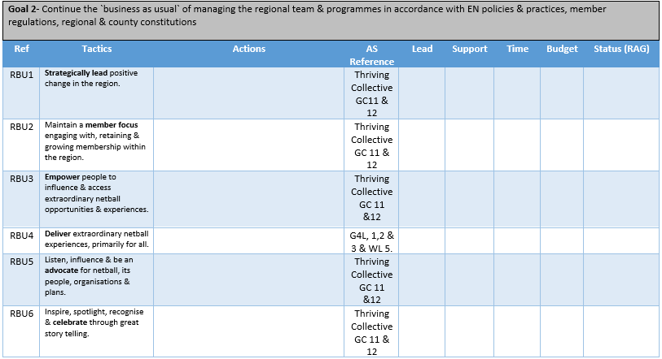

Slide 33
And Finally a BIG! THANK YOU!!....

